Slide 1
Making this resource work for you
Prior to teaching this lesson, please refer to the ‘Unit Overview and Planning Document’.
Further guidance on planning Science Mastery lessons can be found in the detailed planning guidance document.
Refer to the ‘notes’ section on each slide for useful information, including suggested expositions, pedagogical content knowledge, suggested questions, answers and more. Consider using presenter mode so you can see this guidance throughout the lesson.
The introduction slides can be adapted to suit your teaching style and the needs of your class.
Before the lesson, adapt the fix-it slide to address any misconceptions identified in the previous lesson’s exit ticket.
Choose from the suggested activities to suit your class. The intention is not that you complete all of these, but that you select those which ones are most appropriate for your students. It may be appropriate to further adapt activities for your students.
These lessons are designed to occupy approximately 1 hour. To adapt for a shorter or longer lesson duration we advise you to adapt the activity section accordingly.
Please consider using the final slide to send feedback about this lesson or examples of PowerPoints that you have adapted to our design team. Your feedback is used to improve Science Mastery for all of our teachers and students. We appreciate all suggestions and comments.
Thank you for reading!
The Science Mastery Team

Slide 2
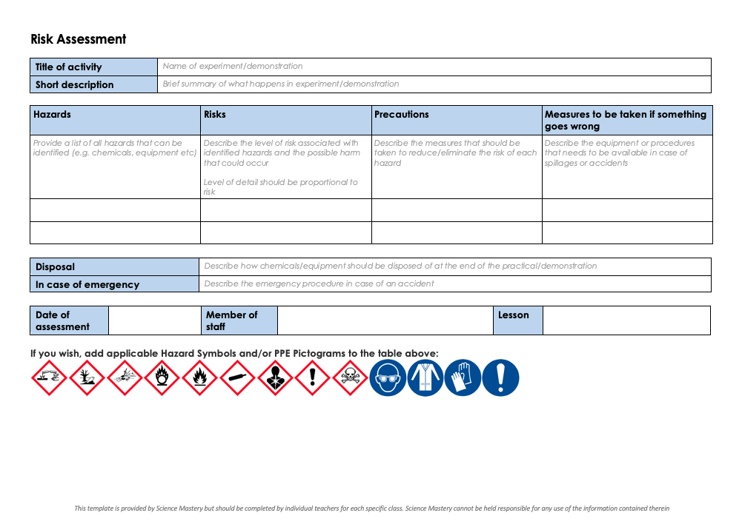
Practical Activity
This lesson contains a practical activity (either a whole class activity or a demonstration)
A risk assessment must be completed for this practical
The template risk assessment can be found here.
The risk assessment should be specific to the class involved and written only by the teaching member of staff
The risk assessment should refer to the current CLEAPSS Hazcards for all chemicals used in the practical for safety and disposal notes.
A list of chemicals used can be found in the Practical Guide
It is good practice for students to wear safety spectacles during all class practicals and demonstrations
Thank you for reading!
The Science Mastery Team

Slide 3
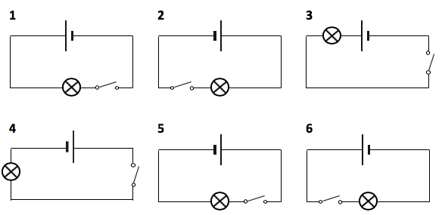

Introduction to Electrolysis
Answer the questions below.
State the equation to calculate power in a circuit.
State the equation used to calculate energy transferred in a circuit.
Write down the ions that are present in potassium oxide.
Draw the symbol for a cell in an electric circuit.
Draw a simple circuit diagram, which contains a cell, a bulb, and a switch connected in series.
Power = current x potential different (P = IV)
energy transferred = current x time x potential difference
K⁺ and O²⁻
Notes:
Big idea: Reactions Rearrange Matter
Foundation: Write a word equation for the reaction where hydrogen gas and oxygen gas react to form water.
Stretch: Write a balanced chemical equation for the reaction where hydrogen gas and oxygen gas react to form water.
Answers:
Foundation: hydrogen + oxygen → water
Stretch: 2H₂ + O₂ → 2H₂O

Slide 4
Introduction to Electrolysis
Do Now:
State the equation to calculate power in a circuit.
State the equation used to calculate energy transferred in a circuit.
Write down the ions that are present in potassium oxide.
Draw the symbol for a cell in an electric circuit.
Draw a simple circuit diagram, which contains a cell, a bulb, and a switch connected in series.
Drill:
Write a word equation for the reaction where hydrogen gas and oxygen gas react to form water.
Write a balanced chemical equation for the reaction where hydrogen gas and oxygen gas react to form water.
Notes:
Answers:
Do Now:
1. Power = current x potential different (P = IV)
2. energy transferred = current x time x potential difference
3. K⁺ and O²⁻
4. See diagram on previous slide
5. See diagram on previous slide
Drill:
1. hydrogen + oxygen → water
2. 2H₂ + O₂ → 2H₂O

Slide 5
Introduction to Electrolysis
Read Now:
A Chinese research team has developed a new processing method to transform seawater into sustainable hydrogen fuel. Seawater is the ideal candidate to be utilised as hydrogen fuel, as it is renewable, extremely abundant, economical, and has the right ingredients to produce high quality hydrogen. Electrolysis involves applying an electric current to water to split it up into it’s constituents, producing hydrogen and oxygen. The resulting hydrogen can be used as clean hydrogen fuel that only emits water when burned, in contrast to fossil fuels that pump out harmful carbon emissions.
What has the Chinese research team developed?
Why is seawater a good substance from which to make fuel?
Define the terms in bold.
Read the underlined sentence again. What do you think the word ‘constituents’ means?
What advantage does hydrogen have as a fuel over fossil fuels?
Notes:
Answers:
The Chinese research team has developed a new method to transform seawater into sustainable hydrogen fuel.
Seawater is a good substance from which to make fuel because it’s renewable, abundant, economical and has the right ingredients to make high quality hydrogen
utilised = used, abundant = there is lots of it, economical = it is good value for money
constituents = parts of something
Hydrogen only emits water when it is burned, whereas fossil fuels produce carbon emissions which contribute to global warming and particulate pollution

Slide 6

C4.2.7
03/02/2025
Introduction to Electrolysis
C4.2.1 PKR: The Reactivity Series
C4.2.2 Extracting Less Reactive Metals
C4.2.3 PKR: Ions, Ionic Bonding and Deducing Ionic Formulae
C4.2.4 (HT) Ionic Equations and Displacement Reactions
C4.2.5 (HT) Writing Half Equations
C4.2.6 (HT) Ionic Equations for the Reactions of Acids and Metals
C4.2.7 Introduction to Electrolysis
C4.2.8 Extracting Metals by Electrolysis
C4.2.9 Electrolysis of Molten Ionic Compounds
C4.2.10 Electrolysis in Solutions
C4.2.11RP: Electrolysis of Aqueous Solutions 1
C4.1.12 RP: Electrolysis of Aqueous Solutions 2
C4.1.13 TIF: Corrosion and its Prevention
C4.2.14 (HT) Obtaining Raw Materials
C4.2.15 Recycling Metals
C4.2.16 Feedback Lesson
Notes:
Big Idea: Reactions Rearrange Matter
Student have already studies half equations. This will be their first opportunity to apply these to the topic of electrolysis. Here we will pull together ideas about extraction of metals, ions, ionic equations and half equations and electricity.
Suggested Hook:
Ask students to guess what the word electrolysis might mean or refer to.

Slide 7

Following this lesson, students will be able to:
Define electrolysis
List the ions present in an electrolyte, and predict their movement when the current is switched on in electrolysis
Explain why electrolysis cannot be carried out with a solid ionic substance
Key Words:
anode
cathode
discharged
electrolysis
electrolyte
Notes:
Guidance:
See unit overview document and planning guidance to see how these objectives are typically assessed at GCSE, including examples of what students should be able to do following this lesson.
Planning for different needs:
The learning objectives given on this slide are suggested based on the most common requirements for exams, however they can be adapted based on the needs of different classes.
For best practice, the unit preparation booklet should be used to determine the appropriate focus of lessons within the unit.
While it is not possible to explicitly split content into levelled grades, we recommend that lesson objectives can be classified as critical, core or stretch.
Critical: the content or skill is essential for all students to be able to progress.
Core: the content or skill is important for students to progress, but other opportunities may be available to revisit it.
Stretch: the content or skill may not be essential for all students but is important for students aiming for the highest grades.
Key skill: this is a crucial skill being developed in this unit as part of the skill mapping
C4.2.7 Lesson Objectives:
Critical: Define electrolysis
Core: List the ions present in an electrolyte, and predict their movement when the current is switched on in electrolysis
Critical: Explain why electrolysis cannot be carried out with a solid ionic substance

Slide 8
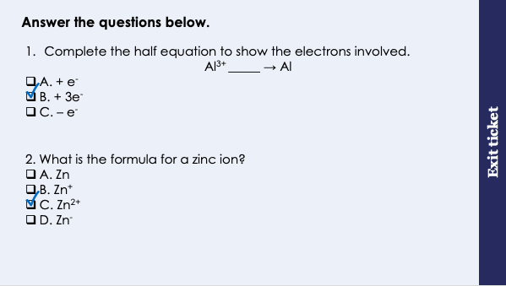
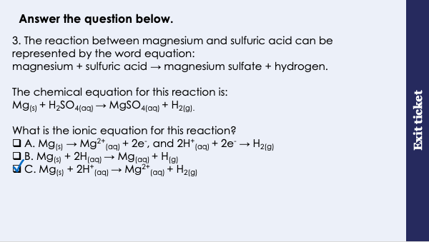
This is the fix-it portion of the lesson
The fix-it is an opportunity to respond to gaps in knowledge, especially those identified by the previous lesson’s exit ticket.
The teacher should customise this slide as needed, to facilitate
reteach, explanation, demonstration or modelling of ideas and concepts that students have not yet grasped or have misunderstood.
practise answering specific questions or of key skills.
redrafting or improving previous work.
Notes:
Fix-it guidance from previous exit ticket:
Q1. Answer: B
If students answer A or C, they do not recognise that to neutralise an ion with a +3 charge, three electrons are required. To fix-it, explain to students that one positive charge and one negative charge (one electron) ‘cancel each other out’ to make a neutral atom. Therefore an ion with a charge of +3 will require 3 electrons to neutralise it. Give students a selection of ionic equations to complete to practise.
If students answer C, they have made the classic mistake of ‘taking away’ the electron by putting a ‘-’ instead of a ‘+’ in the equation. To fix-it, remind students that unlike mathematical expressions, chemical equations only always have + between the substances/species.
Q2. Answer: C
If students answer A, they do not know the difference between an atom and an ion. To fix-it, define the term –ion’ and give students examples of atoms and ions to sort.
If students answer B or D, they are unable to deduce the correct formula for an ion. To fix-it, remind students to refer to the table of common ions.
Q3. Answer: C
If students answer A, they have confused ionic equation with half equation. If students answer B, they have correctly eliminated the spectator ions from the equation but have chosen the option that does not include the correct charges for the ions. To fix-it, model for students the steps of writing an ionic equation from a full chemical equation. Give students some independent practice to do this themselves, using your model to guide them.

Slide 9
Can you list the ions in each substance?
Electrolysis
Example:
Lithium chloride (LiCl)
will split up into
Li⁺ and Cl⁻ ions
Word:
Comes from:
Electro-
-lysis
‘Electricity’
‘splitting’
Definition:
Electrolysis is the process of passing an electric current through a substance, to split it up into its ions.
Electrolyte | Positive ion (cation) | Negative ion (anion)
Sodium chloride
Aluminium oxide
Copper (II) nitrate
Na⁺
Cl⁻
Al³⁺
O²⁻
Cu²⁺
NO₃⁻
Notes:
Exposition type: Explanation
Model teacher exposition:
Let’s look at the word ‘Electrolysis’. Electro- relates to electricity. –lysis refers to ‘splitting up’. So, it makes sense that the definition of electrolysis is ‘the process of passing an electric current through a substance to split it up into its ions’. You may want to ask the class to repeat this definition back to you as a choral response.
Earlier this year you learned about ionic bonding – where ions come together to form a new substance. This is sort of like the opposite of that! If we pass an electric current through an ionic substance, we can split it up into individual ions!
Let’s take lithium chloride as an example, which has the formula LiCl.
If we pass an electric current through this substance, what ions will we be splitting it into? Li⁺ and Cl⁻.
Direct students to refer to the list of ions that is included with this unit as a reference for students, to help them to complete the table on the slide.

Slide 10
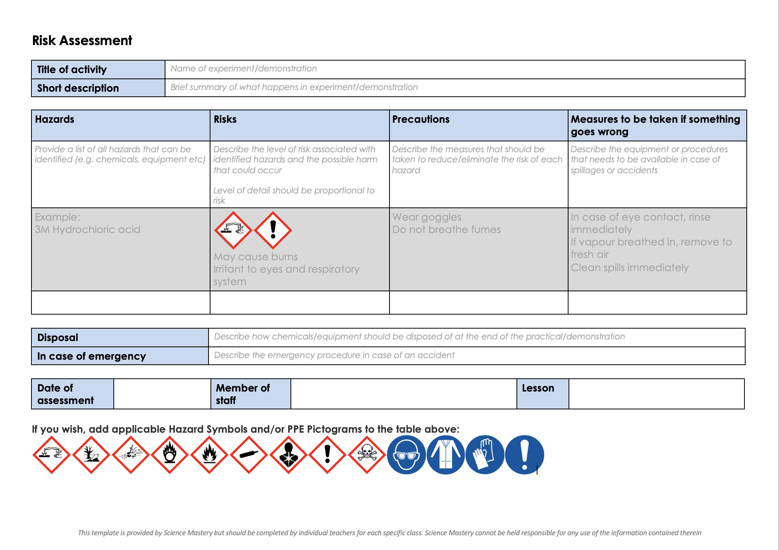
Risk Assessment
A risk assessment must be completed for this practical
The template risk assessment can be found here.

Slide 11
What happens in electrolysis?
Battery or power source
Generates a current to flow through the electrolyte
Anode
Positively charged electrode
-
+
+
Electrolyte
The liquid that contains the ions (current is passed through)
-
-
+
+
Cathode
Negatively charged electrode
-
+
+
-
-
+
-
Notes:
Exposition type: Demonstration
For this part of the lesson you will need a visualiser, and the equipment needed for the migration of ions demonstration (practical guide for this demonstration for more information).
Have a simple electrolysis set up on each desk for students to observe. This could consist of a simple beaker, 2 electrodes, crocodile clips and wires and power pack, with a sodium chloride solution electrolyte. To save time, have these prepared, set up and placed on trays prior to the lesson so that one tray can be placed in front of each group and students simply have to switch the current on to observe the reaction taking place.
Model teacher exposition:
Now you know that electrolysis is the splitting up of substances into their ions, lets look at how this is done.
I have an electrolysis demonstration set up here at the front which you will be able to watch on the screen, and I have also put a different electrolysis set up on your desks. Please do not touch these until I ask you to. Later in this unit you will be carrying out your own electrolysis required practicals, so pay close attention to this demonstration.
Firstly, in order for electrolysis to take place, there are a few things that must always be present. You will see different kinds of electrolysis set ups, like the two you are looking at right now, but they will have these things in common.
Firstly, a battery or power source. Point out the power source under the visualiser and in the set-ups on the desks.
Why do you think a power source is needed for electrolysis? To produce a current of electricity to pass through the substance.
Next, we have two electrodes, one positively charged (the anode) and one negatively charged (the cathode). Notice how the anode is connected to the positive side of the battery and the cathode is connected to the negative side of the battery.
What do you think the electrodes are for? The electrodes carry the current from the wires into the substance (electrolyte) so that the current can pass through the it.
We can use the pneumonic PANIC to remember which electrode is which (Positive Anode, Negative Is Cathode)
Dual code this pneumonic onto the board for students to use later.
Point out the anode and cathode under the visualiser and in the set-ups on the desks.
Remember, electricity is the flow of electrons or ions. In electrolysis, we have a circuit, but part of that circuit is made of the electrolyte. Trace the path of electricity around the circuit with your finger.
Finally, and most importantly, for electrolysis to happen we must have an electrolyte. This is a liquid that contains ions. This is the substance which will be split up when the current passes through it.
Why do you think that the electrolyte must be a liquid? (Clue: Think back to the reason why ionic substances cannot conduct electricity when solid, from C4.2) Electrolysis cannot be carried out with solid substances, because the ions in the substance need to be free to move.
That is why electrolytes will always be molten (melted) substances or substances dissolved in a solvent, like water.
Point out the electrolyte under the visualiser and in the set-ups on the desks.
Now we are going to switch on the power and observe what happens. Ask one student per group to carefully switch on their power packs and do the same for the one under the visualiser. Click through the slide animations to see the ions moving in the animation.
Look at the animation on the screen. What happens to the ions when the current is switched on? They move to the electrodes.
The positive ions (cations) move to the negative electrode (cathode). Here, they gain electrons to become neutral. We say that the ions are discharged.
What is another word for the gain of electrons? Reduction (remember OIL RIG – Oxidation Is Loss of electrons, Reduction Is Gain of electrons)
The negative ions (anions) move to the positive electrode (anode). Here, they lose electrons to become neutral. We say that the ions are discharged
What is another word for the loss of electrons? Oxidation (remember OIL RIG)
Looking at the electrolysis set up. Your electrolyte is sodium chloride. We can see bubbles at the anode. Based on what we have just discussed, what do you think these bubbles are? chlorine
Without inhaling up close, you should be able to smell the chlorine (it’s like a swimming pool smell!)

Slide 12
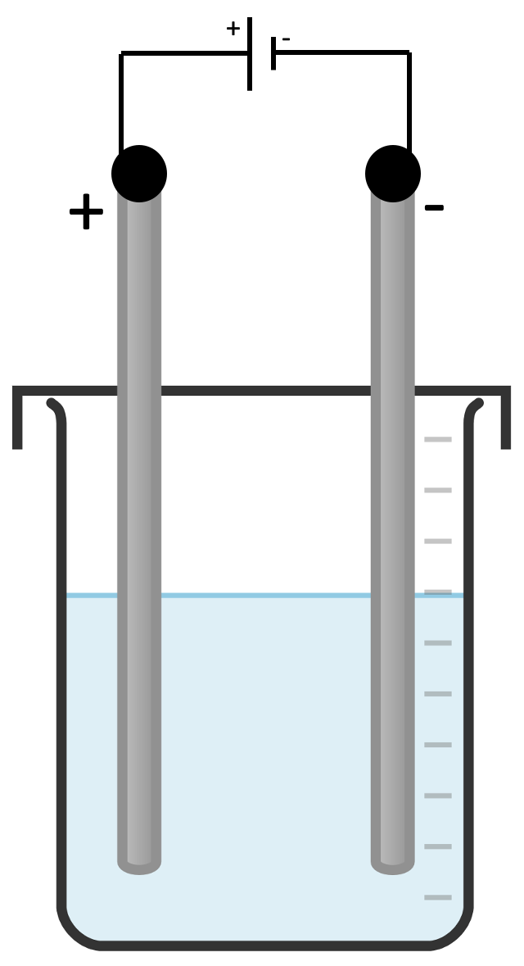
Can you correctly label the electrolysis diagram?
= positively charged ions
= negatively charged ions
cell/battery
cathode
beaker
anode
an inert material
electrolyte
Stretch: the flow of electrons when the circuit is switched on
cation
anion

Slide 13
Writing half equations at each electrode
Higher Tier only
At the anode (+)
anions (negative ions) are discharged
they lose electrons
they are oxidised
At the cathode (-)
cations (positive ions) are discharged
they gain electrons
they are reduced
2F⁻ → F₂ + 2e⁻
2Cl⁻ → Cl₂ + 2e⁻
2O²⁻ → O₂ + 4e⁻
Na⁺ + e⁻ → Na
Li⁺ + e⁻ → Li
Mg²⁺ + 2e⁻ → Mg
Notes:
HT students will halve already learned about writing half equations, and so this should be an opportunity to practise these and apply to the topic of electrolysis.
Model teacher exposition:
Remember: Oxid-A-tion happens at the Anode. Redu-C-tion happens at the Cathode
Or, (vowels together ) Oxidation/Anode, (consonants together) Reduction/Cathode

Slide 14
Consider the electrolysis of molten sodium chloride.
With your partner, see how many points you can make that fit into the two categories below:
What I would observe
What is happening that I could not observe
Notes:
Suggested guidance:
Talk tasks can be used in a variety of ways to suit the particular needs of the students you are teaching. Through exchanging views with others, students develop their understanding of the science beyond what could be achieved individually.
Science classrooms that successfully integrate talk have the following features:
Science talk is a regular feature of lessons and is woven into classroom activities.
Students are paired or grouped strategically by the teacher to ensure productive interaction. This might take into consideration the students’ proficiency of the English language, how encouraging they might be to peers and their attainment in the topic. It’s a good idea to consider these pairings in the class seating plan.
Students are encouraged and supported to talk, but are not forced to talk.
The teacher should take on the role of a facilitator, engaging with conversations where necessary and encouraging or steering the conversation where needed.
Students are encouraged to use the language they have to express their ideas (e.g., everyday language, imperfect English, native language), but also to incorporate science specific terminology where this is more accurate or has been taught.
6. Scientifically inaccurate ideas are not dismissed by the partner or teacher; open discussion and further investigation are relied on to help students construct ideas that support them to progress in their scientific understanding.
7. Guidelines for behaviour during talk tasks are explicit and frequently reviewed. Rules for students might be:
Listen carefully to your partner
Take turns talking.
Speak one at a time, without interrupting.
Politely agree or disagree and explain why.
Politely point out if your partner has used a scientific word incorrectly, if they have explained the science incorrectly, or if there is a more accurate way to describe something.
If confused, ask questions.
Stay focused on the discussion topic.
Respond to one another.

Slide 15
Drill
Define electrolysis.
What is an electrolyte?
What is the positive electrode called?
What is the negative electrode called?
Why does an electrolyte have to be a liquid?
What electrode does a cation move towards?
What electrode does an anion move towards?
At which electrode does oxidation take place?
At which electrode does reduction take place?
(HT only) Write a half equation to show what happens when chloride ions are discharged at the anode.
Notes:
Purpose: This is a knowledge drill. The purpose of this is to check that the critical knowledge is secure before pupils move onto independent practice.
Suggested guidance: There are a range of ways this could be done depending on time and ability range of the class:
Mini whiteboards
As full sentences in exercise books
As short answers in exercise books
In the pupil workbook
As pair talk
As cold call

Slide 16
Drill answers
Electrolysis is the process of passing an electric current through a substance, to break it down into its ions.
An electrolyte is a liquid that contains ions.
The positive electrode is called the anode
The negative electrode is called the cathode
An electrolyte has to be a liquid so that the ions are free to move.
A cation (+) moves towards the cathode (-)
An anion (-) moves towards the anode (+)
Oxidation takes place at the anode
Reduction takes places at the cathode
2Cl⁻ → Cl₂ + 2e⁻
Notes:
Purpose: This is a knowledge drill. The purpose of this is to check that the critical knowledge is secure before pupils move onto independent practice.
Suggested guidance: There are a range of ways this could be done depending on time and ability range of the class:
Mini whiteboards
As full sentences in exercise books
As short answers in exercise books
In the pupil workbook
As pair talk
As cold call

Slide 17
I: Describing what happens in electrolysis
A scientist carried out the electrolysis of sodium chloride.
Describe what will happen when the current is switched on.
When electrolysis occurs, sodium chloride is split up into its ions.
The positive ion (cation) is Na⁺.
Because this ion is positively charged, it will be attracted to the negative electrode (cathode).
Here, the positive ion will be reduced (gains electrons).
(HT only) The half equation for this is Na⁺ + e⁻ → Na
The negative ion (anion) is Cl⁻.
Because this ion is negatively charged, it will be attracted to the positive electrode (anode).
Here, the negative ion will be oxidised (loses electrons)
(HT only) The half equation for this is 2Cl⁻ → Cl₂ + 2e⁻
Notes:
Purpose: The I-We-You section aims to support pupils to build skills that they most commonly need when answering questions associated with this knowledge in the assessment. This section is also used to interleave other content we expect pupils to know at this stage of their education in order that they build a big picture of the science they are learning.
For the ‘I’ activity, the teacher should model how to answer the question. They can do this by narrating their thinking process aloud, and making links to learning earlier in the lesson explicit.
For the ‘we’ activity, the teacher and students work though a similar example together, in order to prepare students to be able to answer a similar question independently.
Opportunities for the ‘you’ activity – independent practise – occur in the activity portion of the lesson once the student is secure enough to process independently.

Slide 18
We: Describing what happens in electrolysis
A scientist carried out the electrolysis of lithium chloride.
Describe what will happen when the current is switched on.
When electrolysis occurs, lithium chloride is split up into its ions.
The positive ion (cation) is Li⁺.
Because this ion is positively charged, it will be attracted to the negative electrode (cathode).
Here, the positive ion will be reduced (gains electrons).
(HT only) The half equation for this is Li⁺ + e⁻ → Li
The negative ion (anion) is Cl⁻.
Because this ion is negatively charged, it will be attracted to the positive electrode (anode).
Here, the negative ion will be oxidised (loses electrons)
(HT only) The half equation for this is 2Cl⁻ → Cl₂ + 2e⁻
Notes:
Purpose: The I-We-You section aims to support pupils to build skills that they most commonly need when answering questions associated with this knowledge in the assessment. This section is also used to interleave other content we expect pupils to know at this stage of their education in order that they build a big picture of the science they are learning.
For the ‘I’ activity, the teacher should model how to answer the question. They can do this by narrating their thinking process aloud, and making links to learning earlier in the lesson explicit.
For the ‘we’ activity, the teacher and students work though a similar example together, in order to prepare students to be able to answer a similar question independently.
Opportunities for the ‘you’ activity – independent practise – occur in the activity portion of the lesson once the student is secure enough to process independently.

Slide 19
You: Describing what happens in electrolysis
A scientist carried out the electrolysis of magnesium oxide.
Describe what will happen when the current is switched on.
When electrolysis occurs, magnesium oxide is split up into its ions.
The positive ion (cation) is Mg²⁺.
Because this ion is positively charged, it will be attracted to the negative electrode (cathode).
Here, the positive ion will be reduced (gains electrons).
(HT only) The half equation for this is Mg²⁺ + 2e⁻ → Mg
The negative ion (anion) is O²⁻.
Because this ion is negatively charged, it will be attracted to the positive electrode (anode).
Here, the negative ion will be oxidised (loses electrons)
(HT only) The half equation for this is 2O²⁻ → O₂ + 4e⁻
Notes:
Purpose: The I-We-You section aims to support pupils to build skills that they most commonly need when answering questions associated with this knowledge in the assessment. This section is also used to interleave other content we expect pupils to know at this stage of their education in order that they build a big picture of the science they are learning.
For the ‘I’ activity, the teacher should model how to answer the question. They can do this by narrating their thinking process aloud, and making links to learning earlier in the lesson explicit.
For the ‘we’ activity, the teacher and students work though a similar example together, in order to prepare students to be able to answer a similar question independently.
Opportunities for the ‘you’ activity – independent practise – occur in the activity portion of the lesson once the student is secure enough to process independently.

Slide 20
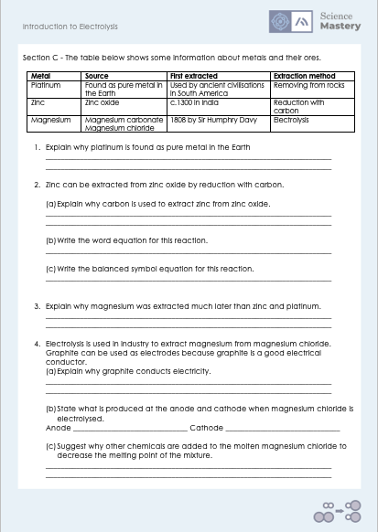
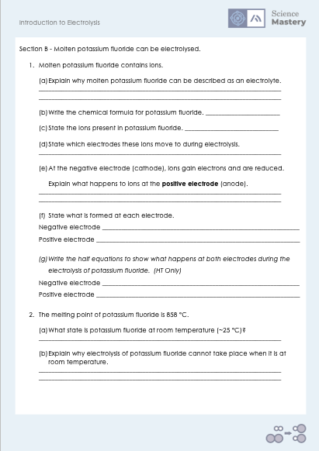
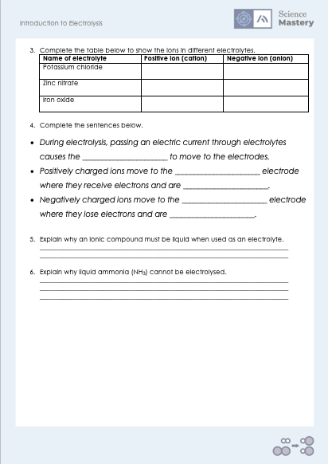
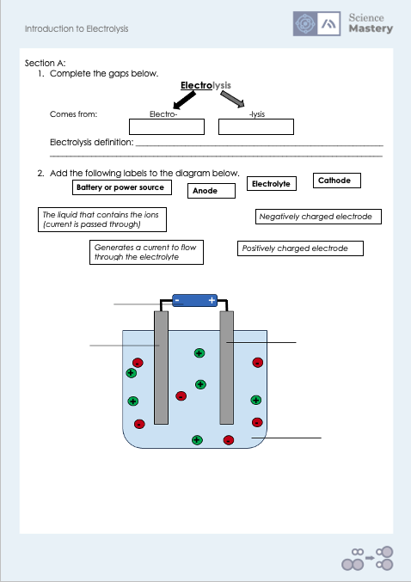
Activity

Slide 21
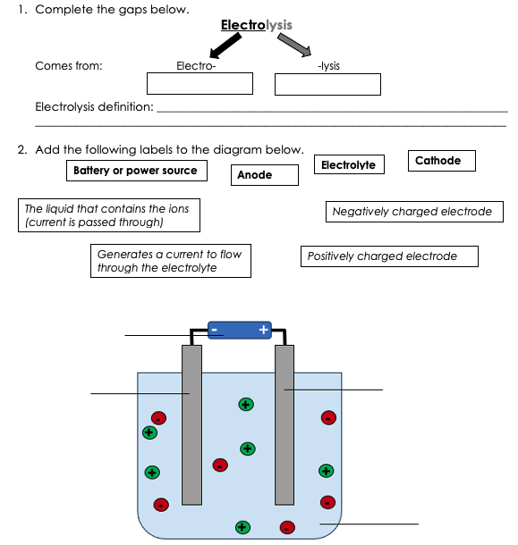
Answers – Section A
Electricity
Splitting
The process of passing an electric current through a substance, to split it up into its ions.
Generates a current to flow through the electrolyte
Battery/power source
Positively charged electrode
Anode
Negatively charged electrode
The liquid that contains the ions
Cathode
Electrolyte

Slide 22
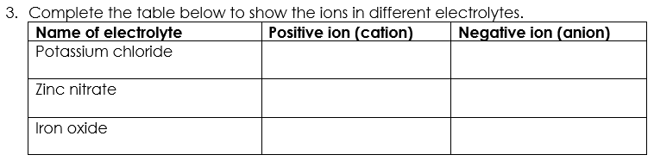
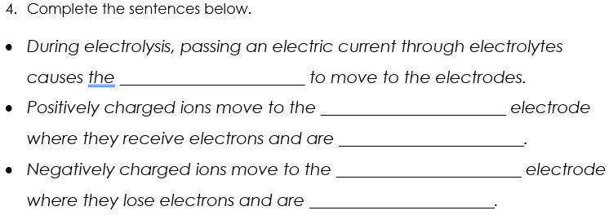
Answers – Section A
K⁺
Cl⁻
Zn²⁺
NO₃⁻
Fe³⁺
O²⁻
ions
negative
reduced
positive
oxidised

Slide 23
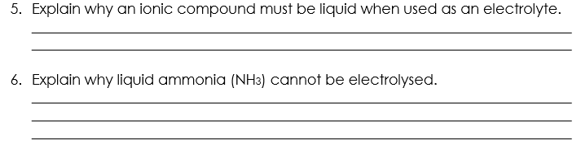
Answers – Section A
So that ions are free to move and conduct electricity around the circuit.
Ammonia has covalent bonds, so will not form ions. This means that ammonia cannot conduct electricity and therefore cannot be electrolysed.

Slide 24
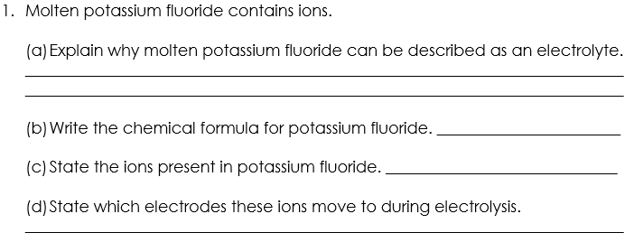
Answers – Section B
Molten potassium fluoride is a liquid where ions are free to move so can conduct electricity during electrolysis.
KF
K⁺ F⁻
K⁺ moves to the negative electrode (cathode) and F⁻ moves to the positive electrode (anode)

Slide 25
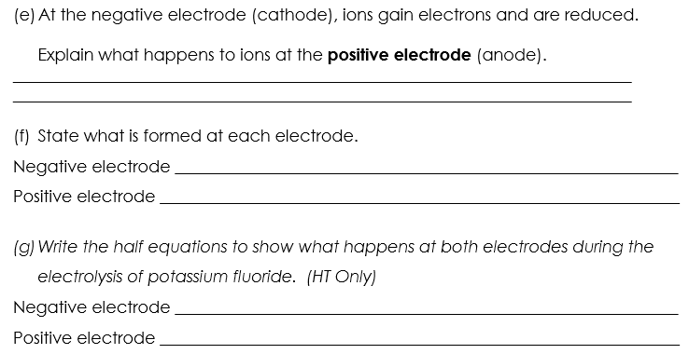
Answers – Section B
At the positive electrode (anode) ions lose electrons and are oxidised.
Potassium atoms are formed
Fluorine atoms are formed
K⁺ + e⁻ → K
2F⁻ → F₂ + 2e⁻
Notes:
Additional answers:
(f) Potassium liquid/solid metal. Fluorine gas.

Slide 26
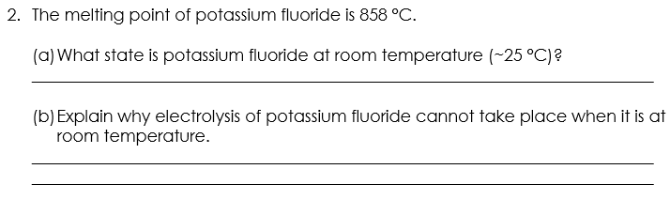
Answers – Section B
Solid
The ions in a solid are not free to move so they cannot conduct electricity, which is required for electrolysis to take place.

Slide 27
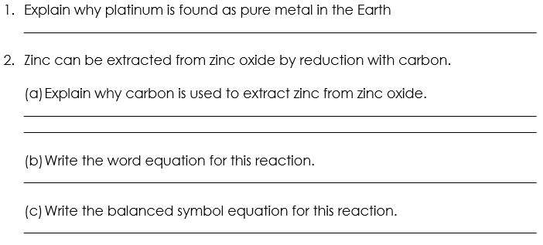
Answers – Section C
Platinum is very unreactive so does not easily form compounds which means it is found as pure metal in the Earth.
Carbon is more reactive than zinc so it displaces it to react with oxide ions to form carbon dioxide.
Zinc oxide + carbon → zinc + carbon dioxide
2ZnO + C → 2Zn + CO₂

Slide 28
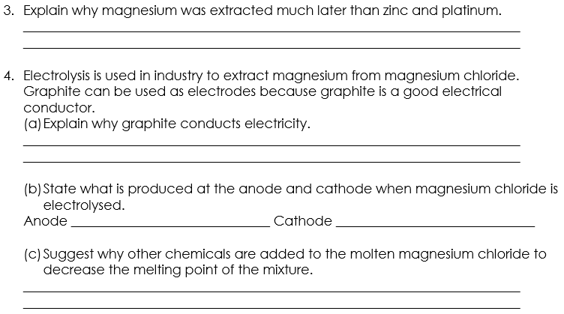
Answers – Section C
Magnesium is more reactive than zinc or platinum so it look longer to develop methods to extract it from its ores.
Even though graphite is made from covalently bound carbon atoms, there are delocalised electrons which allow current to flow.
Chlorine atoms
Magnesium atoms
So less heating it needed to keep the magnesium chloride molten. This is cheaper and less dangerous.

Slide 29

Describe: to recall facts, events or processes in an accurate way
Example question:
Describe what would happen in the electrolysis of molten potassium fluoride (KF).
To ‘describe’, your answer should:
Use bullet points.
Include each step of the process in a logical order.
Use keywords throughout the answer
Stay focused on the question.
Model answer:
When electrolysis occurs, molten potassium fluoride is split up into its ions.
The positive ion (cation) is K⁺.
Because this ion is positively charged, it will be attracted to the negative electrode (cathode).
Here, the positive ion will be reduced (gains electrons).
The negative ion (anion) is F⁻.
Because this ion is negatively charged, it will be attracted to the positive electrode (anode).
Here, the negative ion will be oxidised (loses electrons)
Notes:
This slide models the process of answering a describe question.
Firstly, students are presented with a generic describe question, along with a model answer. Students are also given some simple guidance to follow for producing their own describe answer.
The generic question and answer should be used by the teacher to remind students of
the key features of a great answer
how to structure their answer
why the model answer is a good example
Following this, students will be required to apply this process to answer their own describe question, which will appear in place of the generic questions. This describe question will be specific to the topic students are learning about in the lesson. Give students time to write their own answer to this, ensuring that they use the guidance provided. To further scaffold this task for students, it may be appropriate to:
pair students up to write an answer together
list for students the key words you would like them to include in the answer
provide a writing frame or ‘points to include’ for students
A model answer for this question will appear. Teachers should review the model answer with students by referencing the guidance in the green box. For example ‘we can see item 1 in the guidance is to use bullet points to keep your answer clear. Notice in the model answer here we have done just that’. Or ‘item 2 in the guidance here says that we should use scientific keywords in the answer. Has this been achieved in the model answer? Where can we see this?’.

Slide 30
Answer the questions below.
Which answer correctly describes the 'anode'?
A. a positive ion
B. a negative ion
C. the positive electrode
D. the negative electrode
✓
2. Which answer correctly explains why electrolysis will not work with solid sodium chloride?
A. Solid sodium chloride doesn't conduct electricity because the ions cannot move in a solid
B. Solid sodium chloride doesn't conduct electricity because the particles cannot move in a solid
C. Solid sodium chloride doesn't conduct electricity because the electrons cannot move in a solid
D. Electrolysis will work with solid sodium chloride
✓
Notes:
Q1. Answer: C
If students answer a or b, they are confusing anode and cathode with anion and cation. If students answer D, they are confusing the anode with the cathode. To fix-it, define each of these terms clearly, then annotate an image of an electrolysis set-up with the key words. You may want to use memory tools to help students to recall these words, for example the pneumonic PANIC – ‘Positive Anode, Negative Is Cathode’
Q2. Answer: A
If students answer B or C, they have correctly recalled that solid sodium chloride does not conduct electricity, but they have mixed up (or not been specific enough when using) the words ‘ion’, ‘particle’ and ‘electron’. To fix-it, dual code a diagram of an ionic lattice on the board, labelling the ions within. Explain why ‘ion’ is the best word to use to describe the sodium and chloride ions within.
If students answer D, they have mistakenly thought that electrolysis will work with sodium chloride, perhaps because they think that solid sodium chloride will conduct electricity, To fix-it, ask students to review the properties of ionic substances from unit C4.1, and explain why ionic substances do not conduct electricity when solid.

Slide 31
Answer the question below.
3. Which answer below describes the electrolyte?
A. graphite anode
B. sodium chloride solution
C. sodium and chloride ions
D. the entire diagram
✓
graphite anode
sodium chloride solution
sodium and chloride ions
Notes:
Q3. Answer: B
If students answer A, C or D, they cannot yet identify the electrolyte in an electrolysis set-up. To fix-it, annotate an image of an electrolysis apparatus to show what each part is called. You could show alternative set ups of electrolysis to check that students can still name these parts when they are arranged slightly differently.

Slide 32
Lesson C4.2.7
What was good about this lesson? | What can we do to improve this lesson?
Send us your feedback by clicking this link
or by emailing sciencemastery@arkonline.org
Thank you!

